Slide 1
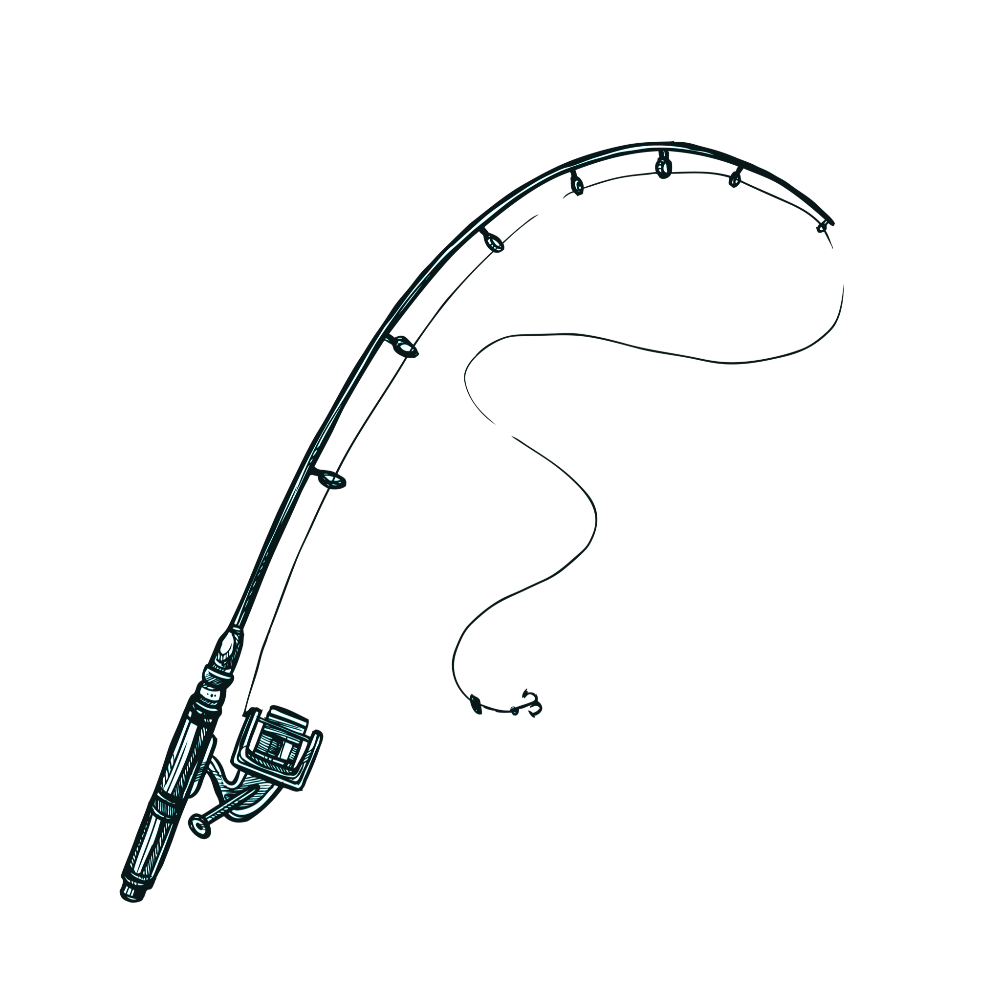
Go-Fish DeltaHacks 12
By: Aaryan, Abeer, Neo and Aiden

Slide 2
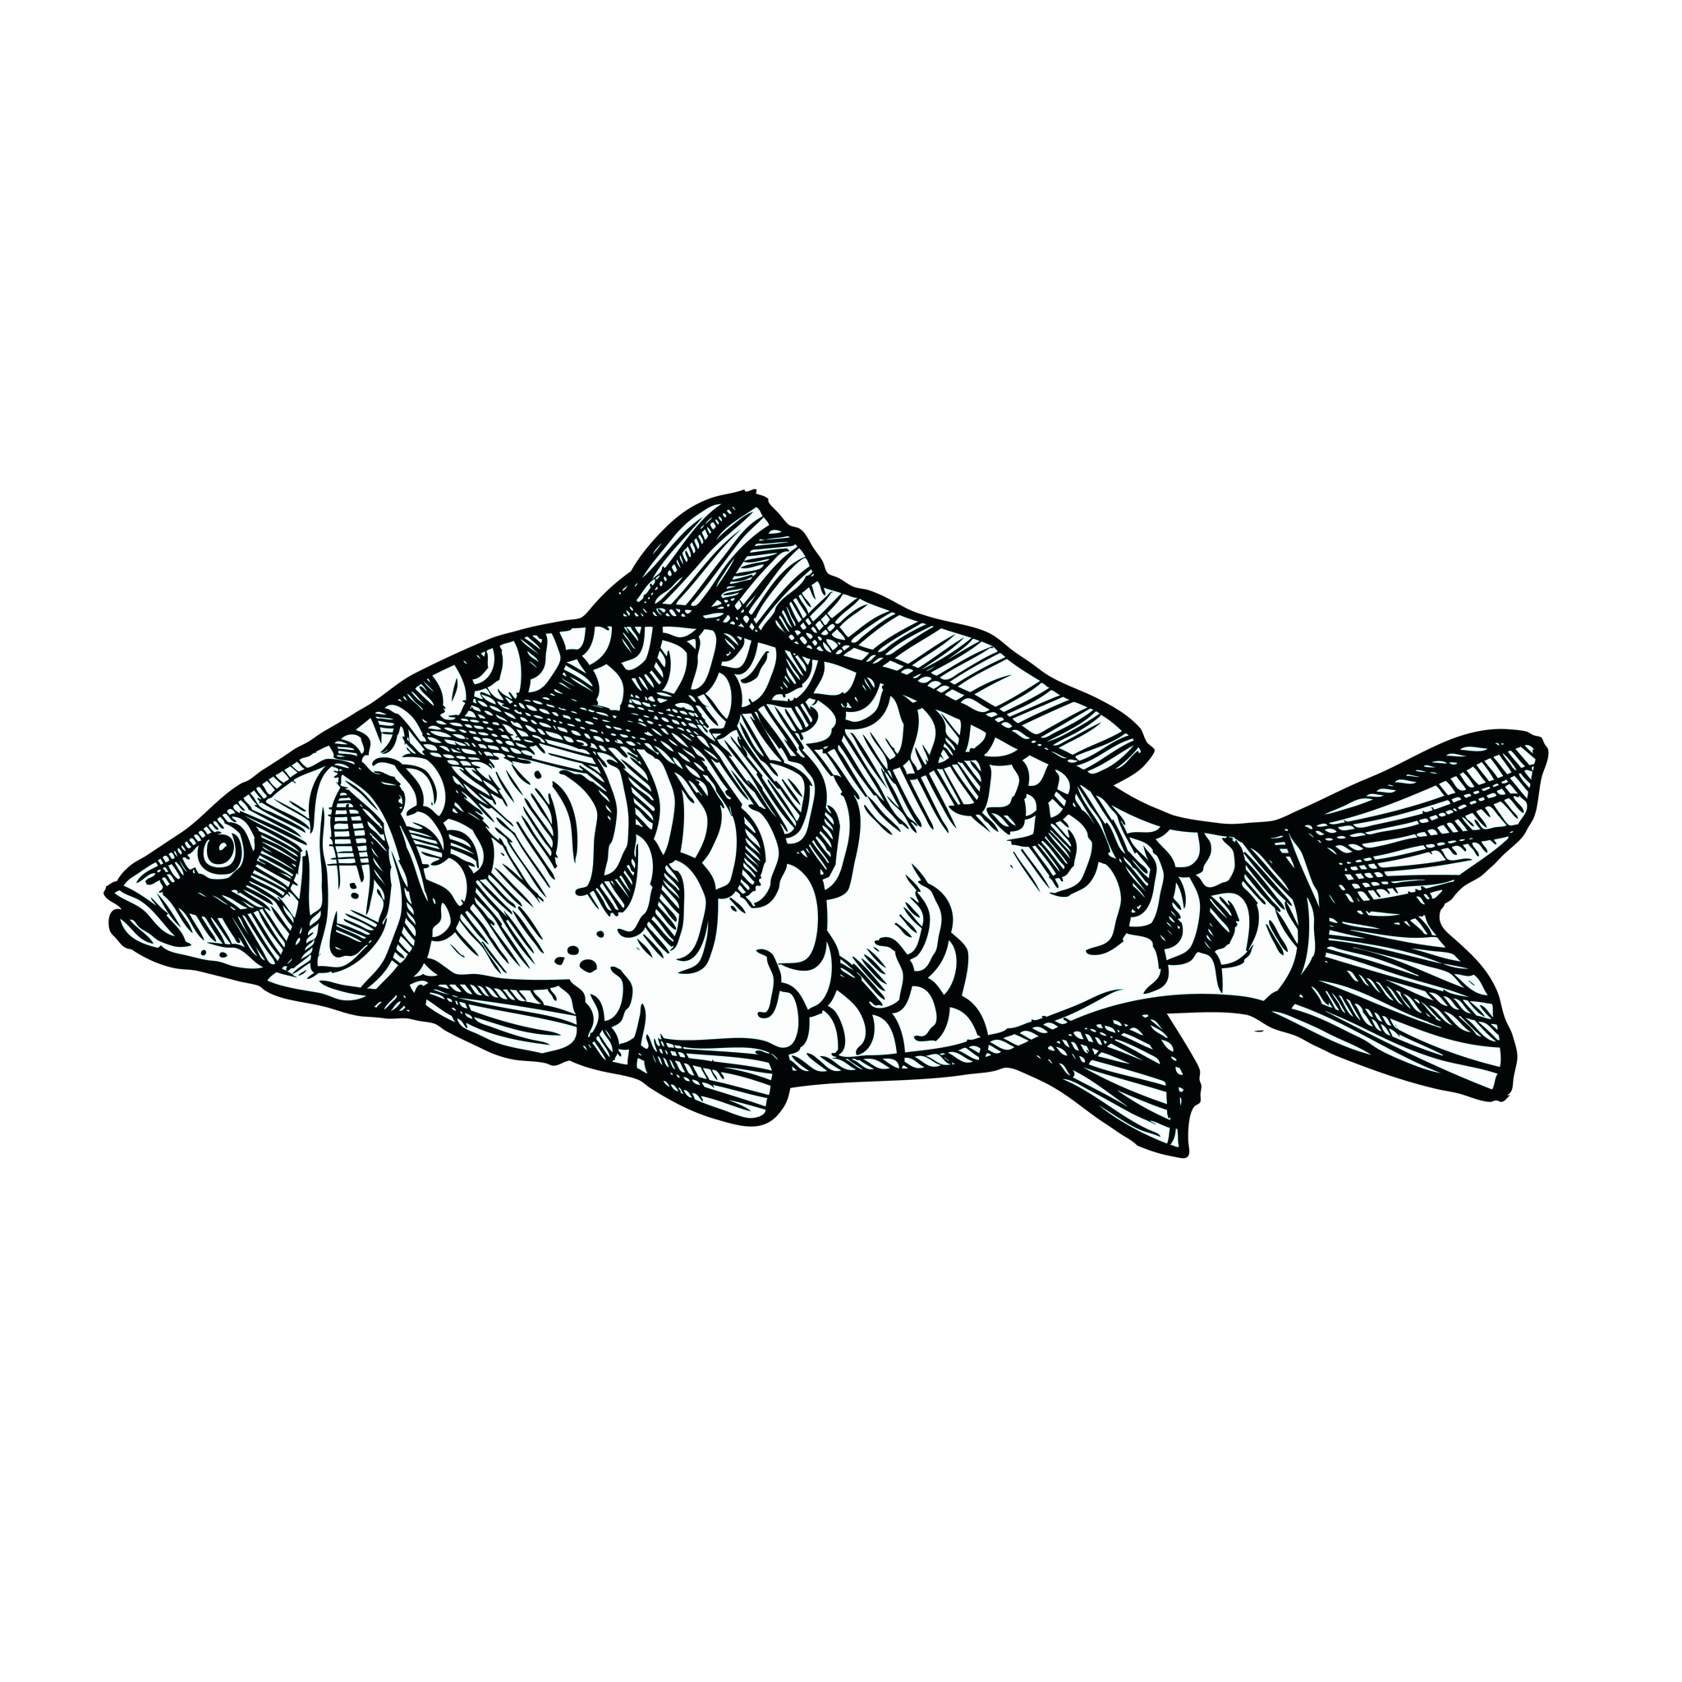
Common problems when fishing
01
02
03
04
What is the best location for me to use my fishfinder (sonar)?
Where should I go to catch a specific fish?
What fish did I actually catch?
Can I actually cook and eat my fish?

Slide 3
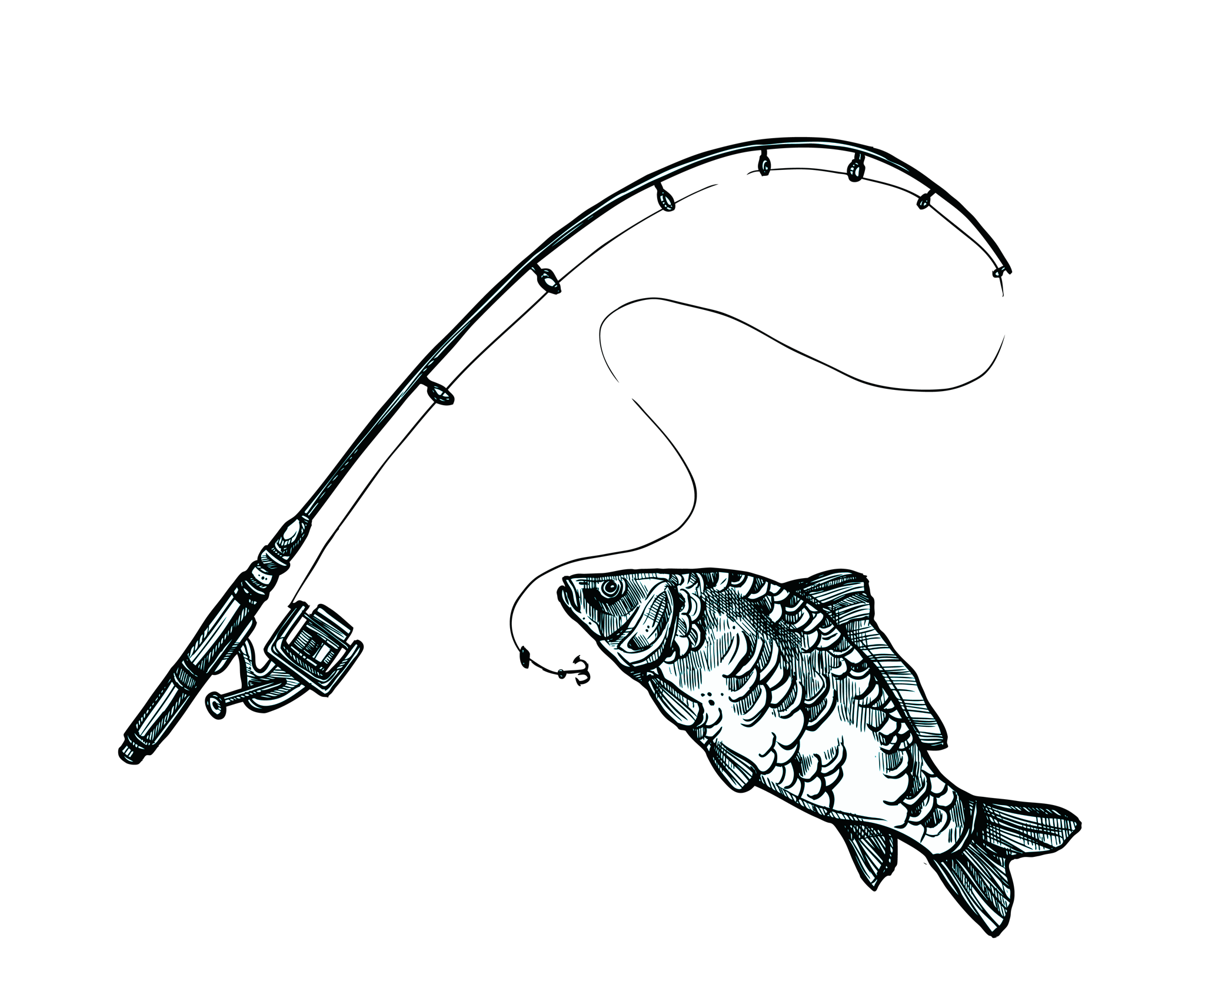
Tech Stack
Frontend
Next.js
Typescript
Tailwind CSS
Backend
Python Fast API
PyTorch (AI Fish Scanner)
Mongo DB Atlas (AI Fish Scanner)
Moorchen (Apps Brain)
Ontario habitat GeoJSON data (Fishing Spot Map)
Environment Canada API (Fishing Spot Map)
Open-meteo API (Fishing Spot Map)
Maplibre GL JS (Fishing Spot Map)

Slide 4
Ways to celebrate Fisheries Day
Fishing Hotspot map
Fish Scanner
Gathers real time weather and marine data, cross references this data with historically documented habitats and breeding grounds for fish and suggests the most optimal locations to go fishing. Also takes into consideration the type of fish you want to find
Identifies fish, determines if it is safe to eat and recipes you can cook
Social Features
Share pictures of your catches and review fishing locations

Slide 5
Use of Mongo DB
Created a vector index search database that takes an image of a fish and identifies its species using a RAG pipeline
Once species was identified, we ran a query to gather information on the fish, whether or not it was safe to eat and possible recipes for the fish
Used the non-relational nature of the database to implement social media features (likes, comments and posts)

